Slide 1

LIBRARY MANAGEMENT SYSTEM
By Under the guidance of
Manoj Nath Goswami Mr Devesh Pandey
And Assistant professor
Pooja Joshi Department of CSE.

Slide 2
TABLE OF CONTENT:
1. INTRODUCTION
1.1. PURPOSE OF PROJECT
1.2. SCOPE OF PROJECT
2. USERS CHARACTERSTICS
2.1. HARDWARE REQUIREMENTS
2.2. SOFTWARE REQUIREMENTS
3. SOFTWARE TOOLS USED
3.1. DATA FLOW DIAGRAM’S
4. SCREEN SHOTS
5. CONCLUSION

Slide 3
Introduction:
Online Library Management System is a system which maintains the information about the books present in the library, their authors, the members of library to whom books are issued, library staff and all.
Implementation starts with entering and updating records like Book Details, Library Information.
Any further transaction like Book Issue, Book Return will automatically update the current books.
It will track on the how many books available in library and books issued to the students.

Slide 4
Purpose
To provide a friendly environment to maintain the details of books and library members.
A library management is a project that manages and stores books information electronically according to students needs.
Improved customer service through greater access to accurate information.
Efficient software solution that improves the management of library resources

Slide 5
Scope
Only covers the requirements specifications for the library management system.
Circulation and User Management: The system handle the borrowing, returning, renewing, and reserving of library materials.
Does not provide any references to the other component of the library management system.
All the dependencies are also identified in this document.

Slide 6
User Characteristics:
We have two levels of users:-
1. User Side- This feature used by the user to login into system. They are required to enter user id and password before they are allowed to enter the system
2. Administration Side- The following are the sub module in the administration side.
Register new user
Register new book
Book issue

Slide 7
Requirements
Functional Requirements:
Book Entry: In this module we can store the details of the books.
Register Student: In this module we can keep the details of the new student.
Book Issue: This module is used to keep the track of book issue details.
Book Return: This module enables to keep a track of returned books.

Slide 8
Hardware Requirements:
System requirements:
The system should prompt for the user and administrator to login to the application and for proper input criteria.
Hardware Requirements:
Operating system: Windows
Hard disk: 500GB
RAM: 1GB
Processor: intel core-i5

Slide 9
Software Requirements:
Operating system- Windows 7 is used as the operating system as it is stable and supports more features and is more user friendly.
Database MYSQL-MYSQL is used as database as it easy to maintain and retrieve records by simple queries which are in English language which are easy to understand and easy to write.
Development tools and Programming language- HTML is used to write the whole code and develop webpages with css, java script for styling work and php for sever side scripting.

Slide 10
SOFTWARE TOOLS USED :
The whole Project is divided in two parts the front end and the back end.
Front end- The front end is designed using of html , Php ,css, Java script.
HTML- HTML or Hyper Text Markup Language is the main markup language for creating web pages and other information that can be displayed in a web browser.
CSS- Cascading Style Sheets(CSS) is a style sheet language used fordescribing the look and formatting of a document written in a markup language.

Slide 11
………
JAVA SCRIPT- JavaScript(JS) is a dynamic computer programming language. It is most commonly used as part of web browsers.
PHP- PHP is a server-side scripting language designed for web development but also used as a general-purpose programming language.
MYSQL- MySQL("My S-Q-L", officially, but also called "My Sequel") is (as of July 2013) the world's second most widely used open-source relational database management system (RDBMS).

Slide 12
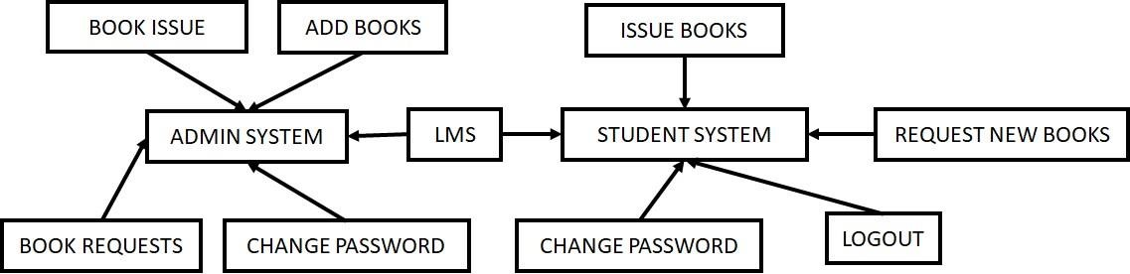
Data flow diagrams:

Slide 13
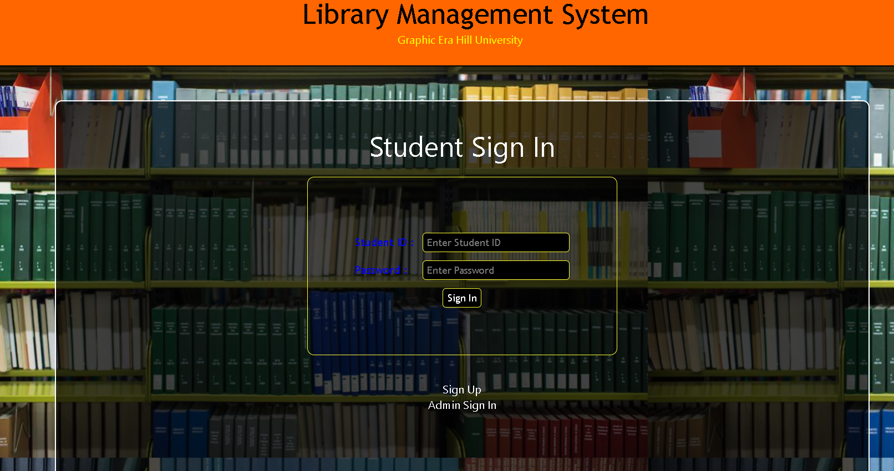
Home Page:

Slide 14
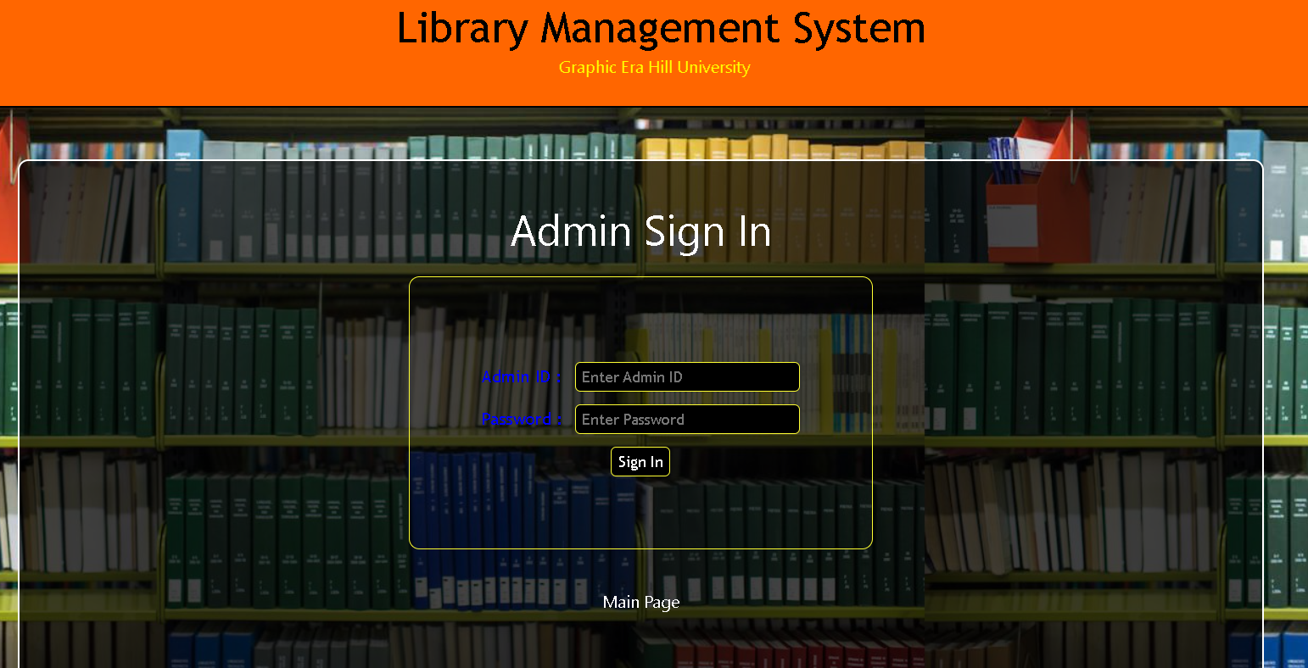
Admin Sign In:

Slide 15
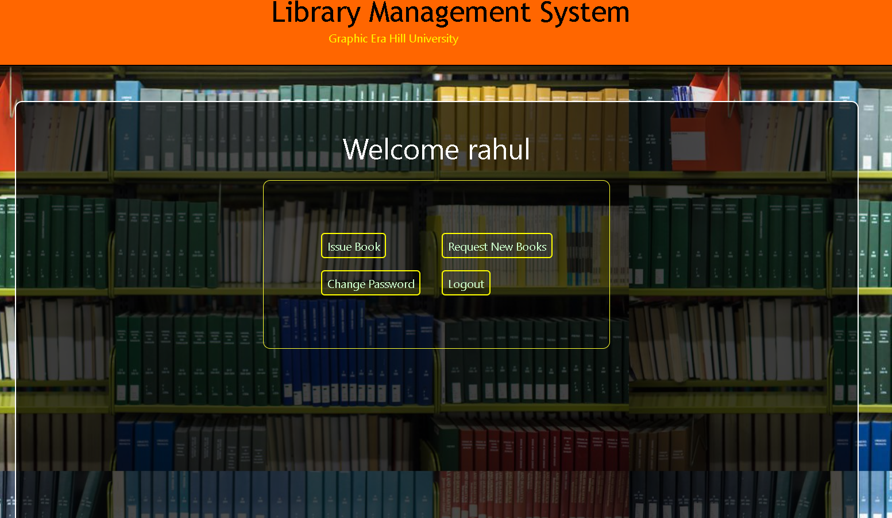

Slide 16
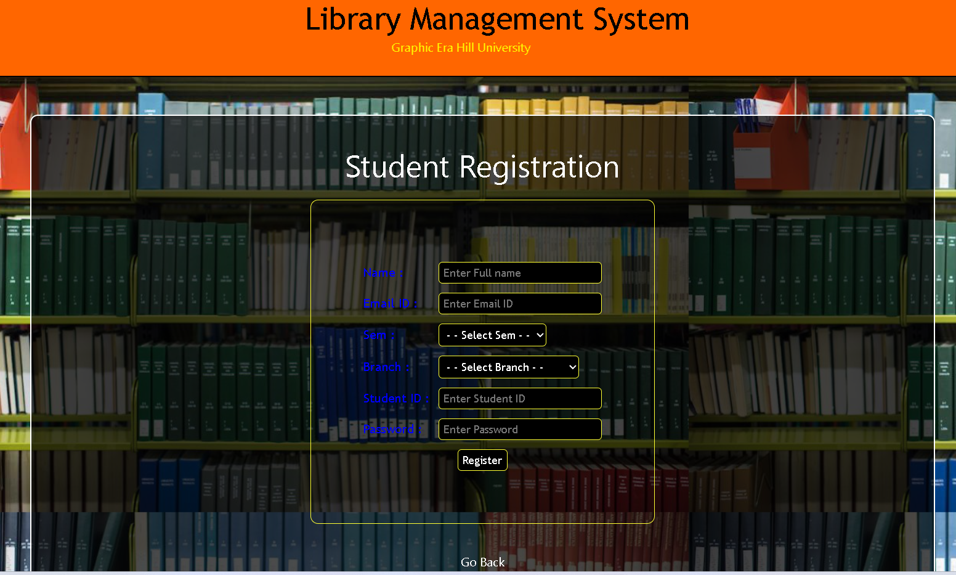

Slide 17
Conclusion
It will take care of the current book detail at any point of time.
The book issue, book return will update the current book details automatically show that user will get the update current book details.
The main purpose of this project is to reduce the manual work.
This software is capable of managing book issues, returns.
Generating various reports for record keeping according to end user requirements.

